Slide 1
IFC5-X-ECS prototype

Slide 2
IFC-ECS Prototype
Emerged out of the API group in Exton
V.01 MVP
A simplified component data schema based closely on IFC4.X
strategy for upgrading object class / instance data.
Simple REST based query
A reference implementation:
IFC4 to (ECS based) IFCJson translator
Web server with IFC file upload, Query service
Web viewer app
Set of principles, approach to collective development
Heavily based on V4, IfcOpenShell, IfcJSON

Slide 3
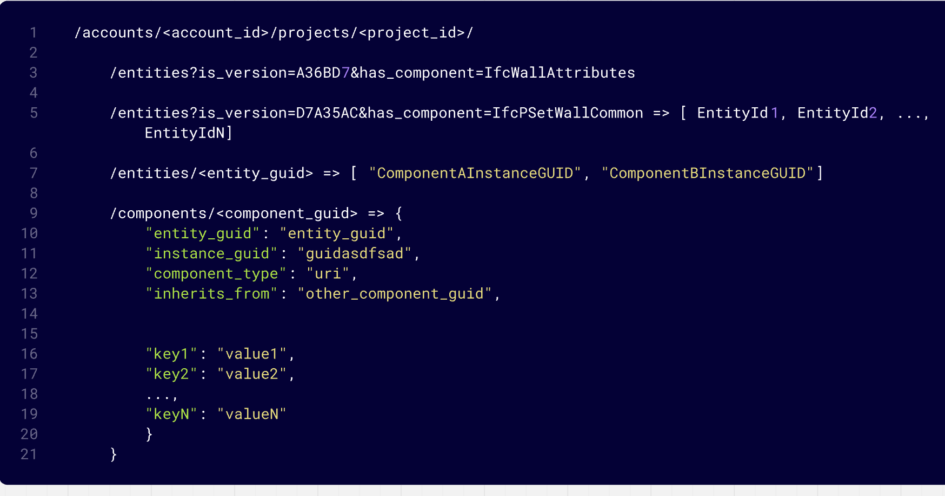

Slide 4
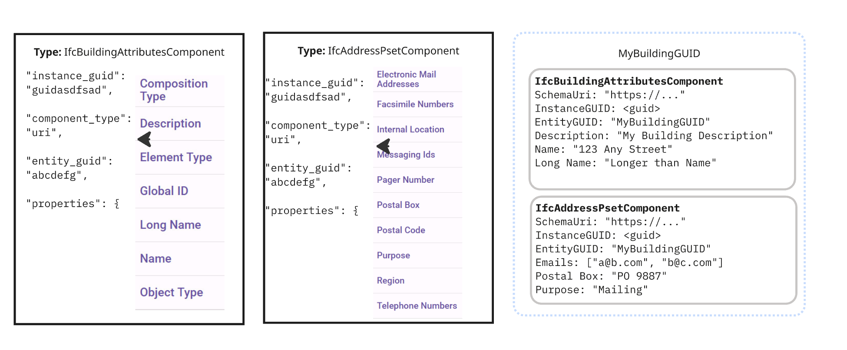

Slide 5
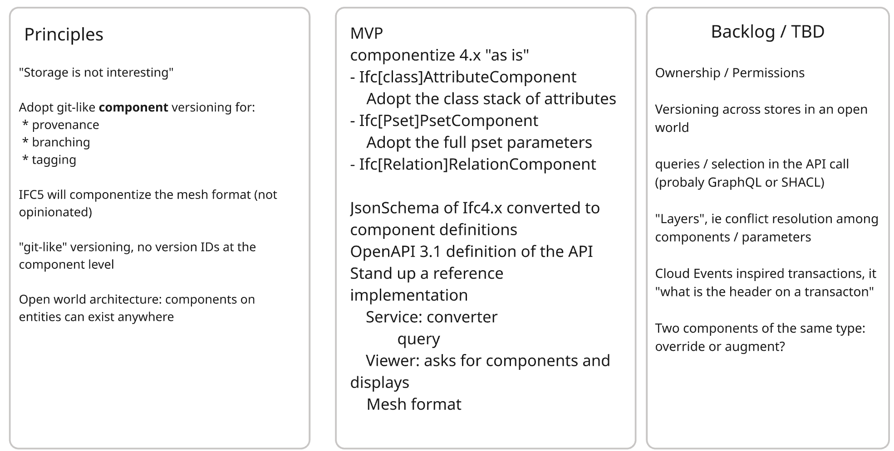

Slide 6
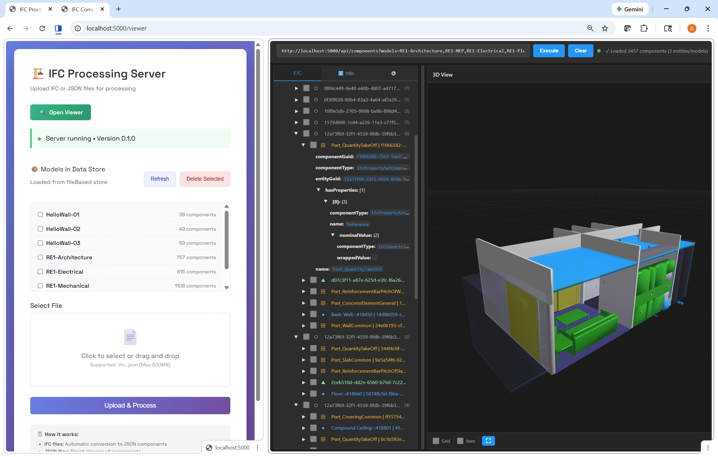

Slide 7
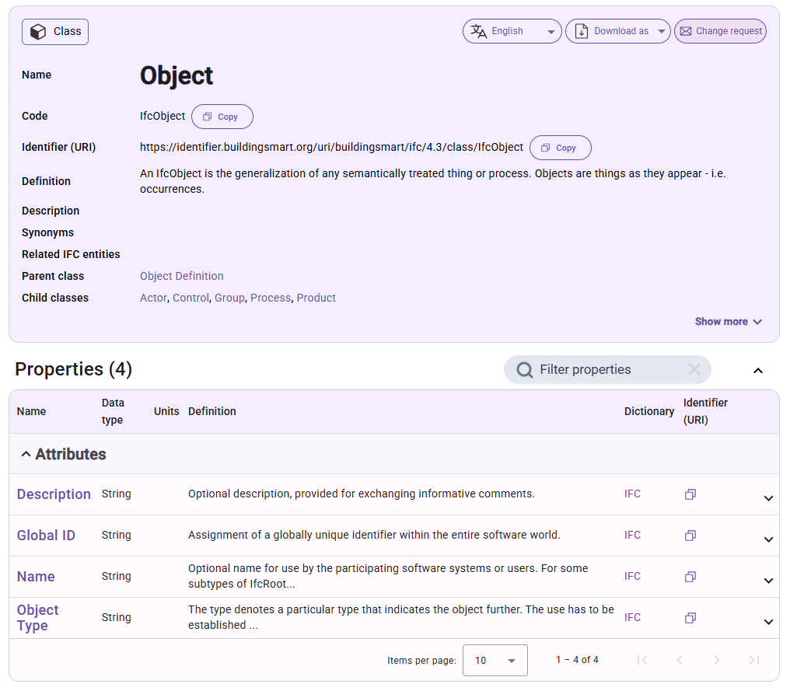
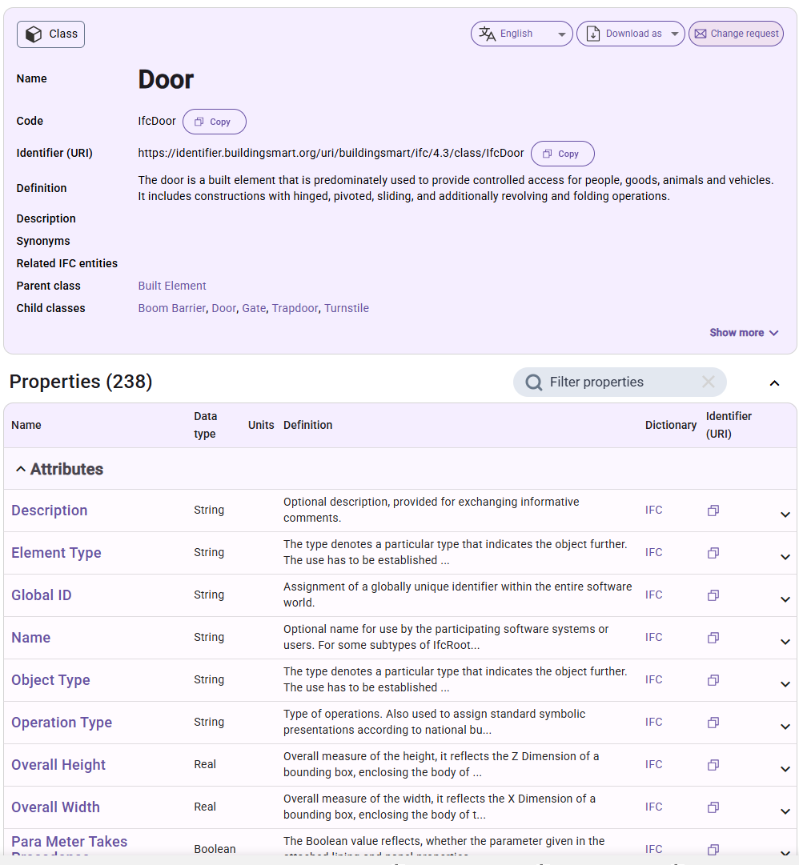
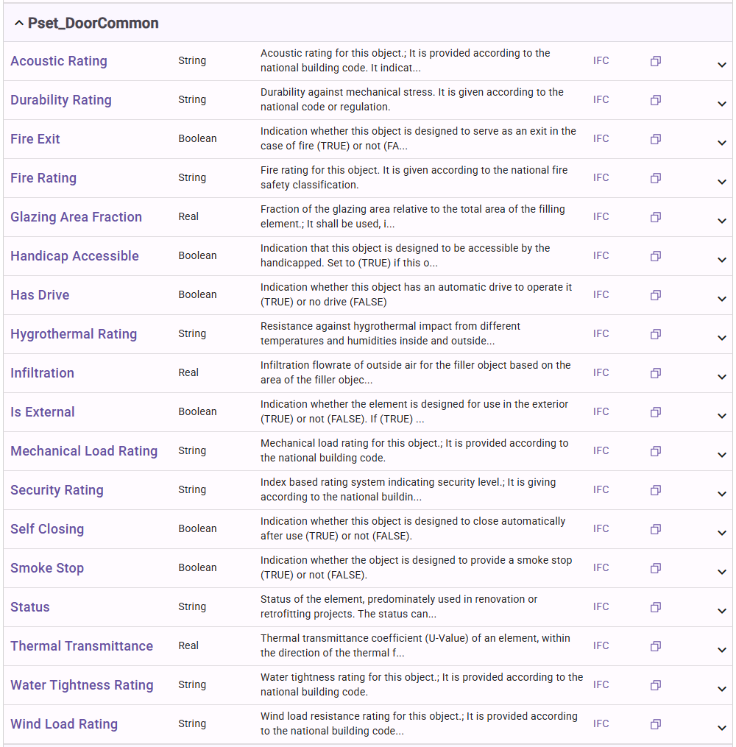
Component data strategy
Starting with:
Object definitions,
Property Sets,
Relations,
ShapeRepresentations,
…
Class Definition with Instance parameters
Property Sets

Slide 8
Data migration strategy
0d68ad35-29c7-484d-907c-65a3fbc0eadb
(IfcDoor)
ClassType Component
IfcDoor
Propertyset Component
IfcDoor
EntityGuid
EntityType
ComponentGuid
ComponentType
EntityGuid
ComponentGuid
ComponentType

Slide 9
Data migration strategy
0d68ad35-29c7-484d-907c-65a3fbc0eadb
(IfcDoor)
ClassType Component
IfcDoor
Propertyset Component
IfcDoor
<- V4 IFC ID
<- The V4 class name
<- New Guid
<- EntityType+Component
<- Guid of Entity
<- V4 IFC ID
ComponentType <- IFCPropertySet
EntityGuid
EntityType
ComponentGuid
ComponentType
EntityGuid
ComponentGuid
ComponentType

Slide 10
{
"componentGuid": "5c890f20-ee21-063a-7d35-3cffdf73b494",
"componentType": "IfcDoorComponent",
"entityGuid": "f1c8fc3e-82ee-4c75-ae69-2b1be0926228",
"entityType": "IfcDoor",
"name": "Door-Passage-Single-Flush:36\" x 84\":1240792",
"objectType": "Door-Passage-Single-Flush:36\" x 84\"",
"overallHeight": 7.333333333333333,
"overallWidth": 3.333333333333333,
"tag": "1240792"
}
{
"componentGuid": "933c4a06-93b8-11d3-80f8-00c14f8efc2c",
"componentType": "IfcRelContainedInSpatialStructureComponent",
"relatedElements": [
"0d68ad35-29c7-484d-907c-65a3fbc0eadb"
],
"relatingStructure": "933c4a06-93b8-11d3-80f8-00c04f8efc2c"
},
ClassTypeCompenent
{
"componentGuid": "6d533265-65f4-fc00-e847-7e73cc3ab3f7",
"componentType": "IfcPropertySetComponent",
"entityGuid": "f1c8fc3e-82ee-4c75-ae69-2b1be0926228",
"hasProperties": [
{
"componentType": "IfcPropertySingleValueComponent",
"name": "Reference",
"nominalValue": {
"componentType": "IfcIdentifierComponent",
"wrappedValue": "36\" x 84\""
}
}
],
"name": "Pset_QuantityTakeOff"
}
RelationshipCompenent – by reference
{
"componentGuid": "5ee46b9f-a508-fc7b-3fde-e8df6c667753",
"componentType": "IfcRelAssociatesMaterialComponent",
"relatedObjects": [
"0d68ad35-29c7-484d-907c-65a3fbc0eadb"
],
"relatingMaterial": {
"componentType": "IfcMaterialLayerSetUsageComponent",
"directionSense": "NEGATIVE",
"forLayerSet": {
"componentType": "IfcMaterialLayerSetComponent",
"layerSetName": "Basic Wall:Generic - 8\"",
"materialLayers": [
{
"componentType": "IfcMaterialLayerComponent",
"layerThickness": 0.6666666666666666,
"material": {
"componentType": "IfcMaterialComponent",
"name": "Default Wall"
}
}
]
},
"layerSetDirection": "AXIS2",
"offsetFromReferenceLine": 0.3333333333333333
}
},
PropertySetCompenent
{
"componentGuid": "cbb1b9d8-b5b8-d604-1715-c5157acc3229",
"componentType": "IfcShapeRepresentationComponent",
"entityGuid": "f1c8fc3e-82ee-4c75-ae69-2b1be0926228",
"representationIdentifier": "Body",
"representationFormat": "OBJ",
"items": [
"v -2.01486169281188 0.023749999999998328 1.0089289321881372\n
f 13 2 3\nf 13 3 4\nf 13 4 5\nf 13 5 6\nf 13 6 7\nf 13 7 8\n”
]
}
ShapeRepresentationCompenent
RelationshipCompenent – by value

